Slide 1
Object Oriented Method && C++ Program Design
Programming
Principles and Practice Using C++
Lecture 6 – Inheritance
Shengfa Wang
sfwang@dlut.edu.cn

Slide 2
Contents
Base and Derived Classes
  Single Inheritance
  Declaration of derived classes
  Order of Constructor and Destructor Execution
  Inherited member accessibility
Multiple Inheritance(optional)
Virtual Base Classes(*)

Slide 3
Terminology
Inheritance is a form of software reuse where a new class is created to
  absorb an existing class’s data and behaviors, and
  enhance them with new capabilities
The new class, the derived class, inherits the members of the existing class, known as the base class
  A base class is a previously defined class that is used to define new classes
  A derived class inherits the data and function members of a base class

Slide 4
Single/Multiple Inheritance
A direct base class is the base class from which a derived class explicitly inherits.
An indirect base class is inherited from two or more levels up in the class hierarchy.
In single inheritance, a class is derived from one base class.
With multiple inheritance, a derived class inherits from multiple base classes.

Slide 5
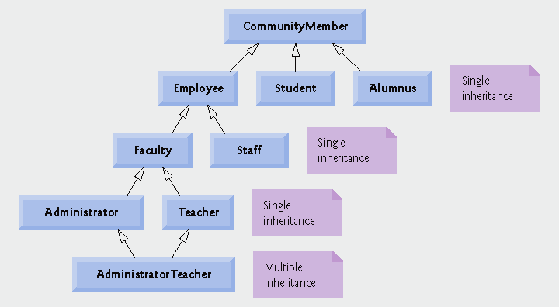
Class Hierarchy
Members of a university
community

Slide 6
Example 1:
Student
name
id
major
Undergraduate
year
minor
etc.
Graduate
advisor
thesis
research
etc...

Slide 7
Example 2:
Publication:
publisher
date
Magazine:
# of issues per year
circulation
Book:
ISBN
author
Notes:
Circulation 发行量

Slide 8
Example
class A
{
//100 Features
};
class B
{
//99 Same, and 2 Different Features
};
: public A
//copy 99 same features
//create 2 new features
//create 2 new features

Slide 9
class A
{
private:
protected:
public:
};
class B : private/protected/ public A
{
//create 2 new features
//99 Same, and 2 Different Features
};

Slide 10
Example
#include<iostream>
using namespace std;
class Animal{
public:
void speak(){cout << "Grrrrr" << endl;}
};
int main(){
Animal a;
a.speak();
return 0;
}

Slide 11
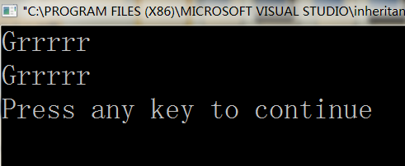
#include<iostream>
using namespace std;
class Animal{
public:
void speak(){cout << "Grrrrr" << endl;}
};
class Cat:public Animal{
};
int main(){
Animal a;
a.speak();
Cat cat;
cat.speak();
return 0; }

Slide 12
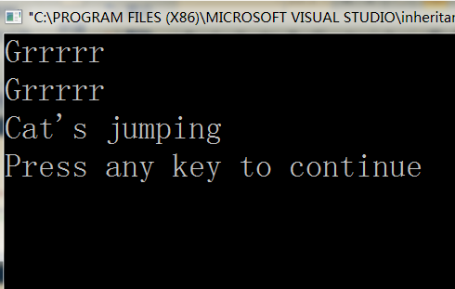
#include<iostream>
using namespace std;
class Animal{
public:
void speak(){cout << "Grrrrr" << endl;}
};
class Cat:public Animal
{
public:
void jump(){cout << "Cat's jumping" <<endl;}
};
int main(){
Animal a;
a.speak();
Cat cat;
cat.speak();
cat.jump();
return 0;
}

Slide 13
#include<iostream>
using namespace std;
class Animal{
public:
void speak(){cout << "Grrrrr" << endl;}
};
class Cat: public Animal{
public:
void jump(){cout << "Cat's jumping" <<endl;}
};
int main(){
Animal a;
a.speak();
Cat cat;
cat.speak();
cat.jump();
return 0;
}

Slide 14
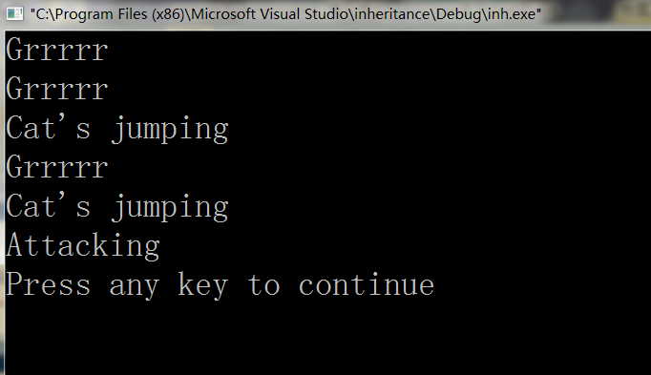
#include<iostream>
using namespace std;
class Animal{
public:
void speak(){cout << "Grrrrr" << endl;}
};
class Cat:public Animal{
public:
void jump(){cout << "Cat's jumping" <<endl;}
};
class Tiger: public Cat{
public:
void attack(){cout<<"Attacking"<<endl;}
};
int main(){
Animal a;
a.speak();
Cat cat;
cat.speak();
cat.jump();
Tiger tiger;
tiger.speak();
tiger.jump();
tiger.attack();
return 0;
}

Slide 15
#include<iostream>
using namespace std;
class Animal{
public:
void speak(){cout << "Grrrrr" << endl;}
};
class Cat:public Animal{
public:
void jump(){cout << "Cat's jumping" <<endl;}
};
class Tiger: public Cat{
public:
void attack(){cout<<"Attacking"<<endl;}
};
int main(){
Animal a;
a.speak();
Cat cat;
cat.speak();
cat.jump();
Tiger tiger;
tiger.speak();
tiger.jump();
tiger.attack();
return 0;
}
cat.attack();

Slide 16
Class Derivation Constructors and Destructors
Constructors and destructors are not inherited
  Each derived class should define its constructors/destructor
  If no constructor is written=> hidden constructor is generated and will call the base default constructor for the inherited portion and then apply the default initialization for any additional data members
When a derived object is instantiated, memory is allocated for
  Base object
  Added parts
Initialization occurs in two stages:
  the base class constructors are invoked to initialize the base objects
  the derived class constructor is used to complete the task
The derived class constructor specifies appropriate base class constructor in the initialization list
  If there is no constructor in base class, the compiler created default constructor used
If the base class is derived, the procedure is applied recursively

Slide 17
#include<iostream>
using namespace std;
class Animal{
public:
Animal(){cout<<"Animal no-argument constructor called"<<endl;}
};
int main(){
Animal animal;
return 0;
}

Slide 18
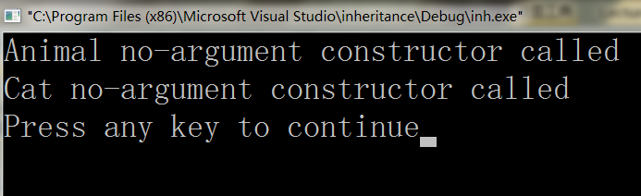
#include<iostream>
using namespace std;
class Animal{
public:
Animal(){cout<<"Animal no-argument constructor called"<<endl;}
};
class Cat:public Animal{
public:
Cat(){cout<<"Cat no-argument constructor called"<<endl;}
};
int main(){
Cat cat;
return 0;
}

Slide 19
Inherited Member Initialization
Initialized in two ways:
  If the base class has only a default constructor=> initialize the member values in the body of the derived class constructor
  If the base class has a constructor with arguments=> the initialization list is used to pass arguments to the base class constructors
syntax (for Single Base Class)
DerivedClass ( derivedClass args ) : BaseClass ( baseClass args ) {
DerivedClass constructor body
}
The set of derived class constructor arguments may contain initialization values for the base class arguments

Slide 20
#include<iostream>
using namespace std;
class Animal{
private:
int id;
public:
Animal():id(0){cout<<"Animal no-argument constructor called"<<endl;}
void info(){cout <<"ID:"<< id <<endl;}
};
class Cat:public Animal{
public:
Cat(){cout<<"Cat no-argument constructor called"<<endl;}
};
int main(){
Cat cat;
cat.info();
return 0;
}

Slide 21
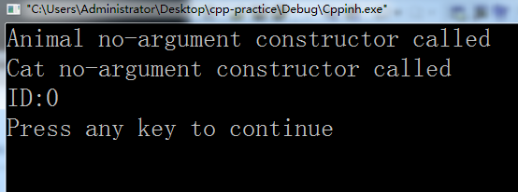
#include<iostream>
using namespace std;
class Animal{
private:
int id;
public:
Animal():id(0){cout<<"Animal no-argument constructor called"<<endl;}
void info(){cout <<"ID:"<< id <<endl;}
};
class Cat:public Animal{
public:
Cat() {cout<<"Cat no-argument constructor called"<<endl;}
};
int main(){
Cat cat;
cat.info();
return 0;
}
:id(0)

Slide 22
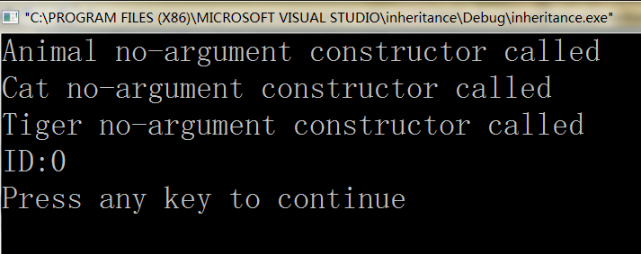
int main(){
Tiger tiger;
tiger.info();
return 0;
}
#include<iostream>
using namespace std;
class Animal{
private:
int id;
public:
Animal():id(0){cout<<"Animal no-argument constructor called"<<endl;}
void info(){cout <<"ID:"<< id <<endl;}};
class Cat:public Animal{
public:
Cat(){cout<<"Cat no-argument constructor called"<<endl;}
};
class Tiger: public Cat{
public:
Tiger(){cout<<"Tiger no-argument constructor called"<<endl;}
};

Slide 23
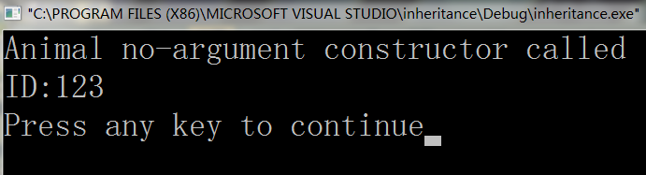
#include<iostream>
using namespace std;
class Animal{
private:
int id;
public:
Animal():id(0){cout<<"Animal no-argument constructor called"<<endl;}
void info(){cout <<"ID:"<< id <<endl;}};
class Cat:public Animal{
public:
Cat(){cout<<"Cat no-argument constructor called"<<endl;}
};
class Tiger: public Cat{
public:
Tiger(){cout<<"Tiger no-argument constructor called"<<endl;}
};
int main(){
return 0;
}
Animal animal(123);
animal.info();
Animal(int aid):id(aid){cout<<"Animal no-argument constructor called"<<endl;}

Slide 24
#include<iostream>
using namespace std;
class Animal{
private:
int id;
public:
Animal():id(0){cout<<"Animal no-argument constructor called"<<endl;}
Animal(int aid):id(aid){cout<<"Animal parameterized constructor called"<<endl;}
void info(){cout <<"ID:"<< id <<endl;}};
class Cat:public Animal{
public:
Cat(int aid):Animal(aid){cout<<"Cat parameterized constructor called"<<endl;}
Cat(){cout<<"Cat no-argument constructor called"<<endl;}
};
class Tiger: public Cat{
public:
Tiger(){cout<<"Tiger no-argument constructor called"<<endl;}
};
int main(){
Cat cat(123);
cat.info();
return 0;
}

Slide 25
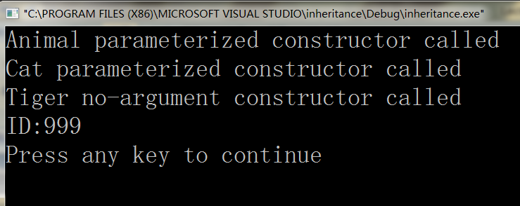
#include<iostream>
using namespace std;
class Animal{
private:
int id;
public:
Animal():id(0){cout<<"Animal no-argument constructor called"<<endl;}
Animal(int aid):id(aid){cout<<"Animal parameterized constructor called"<<endl;}
void info(){cout <<"ID:"<< id <<endl;}};
class Cat:public Animal{
public:
Cat(int aid):Animal(aid){cout<<"Cat parameterized constructor called"<<endl;}
Cat(){cout<<"Cat no-argument constructor called"<<endl;}
};
class Tiger: public Cat{
public:
Tiger() {cout<<"Tiger no-argument constructor called"<<endl;}
};
int main(){
return 0;
}
Tiger tiger;
tiger.info();
:Cat(999)

Slide 26
#include<iostream>
using namespace std;
class Animal{
private:
int id;
public:
Animal():id(0){cout<<"Animal no-argument constructor called"<<endl;}
Animal(int aid):id(aid){cout<<"Animal parameterized constructor called"<<endl;}
~Animal(){cout<<"Animal destructor is called"<<endl;}
void info(){cout <<"ID:"<< id <<endl;}};
class Cat:public Animal{
public:
Cat(int aid):Animal(aid){cout<<"Cat parameterized constructor called"<<endl;}
Cat(){cout<<"Cat no-argument constructor called"<<endl;}
~Cat(){cout<<"Cat destructor is called"<<endl;}
};
class Tiger: public Cat{
public:
Tiger() {cout<<"Tiger no-argument constructor called"<<endl;}
~Tiger(){cout<<"Tiger destructor is called"<<endl;} };
int main(){
return 0;}
Tiger tiger;
tiger.info();
:Cat(999)

Slide 27
What to inherit?
In principle, every member of a base class is inherited by a derived class
  just with different access permission

Slide 28
Inheritance and access specifiers
class A
{
private:
protected:
public:
};
class B : private/protected/ public A
{
//create 2 new features
//99 Same, and 2 Different Features
};

Slide 29
Class Derivation
Any class can serve as a base class…
  Thus a derived class can also be a base class
  Worth spending time at the outset of a design to develop sound definitions
  syntax
    class DerivedClassName:specification BaseClassName
    DerivedClassName - the class being derived
    specification - specifies access to the base class members
    public
    protected
    private
    - private by default
The protected access specifier means that the member data or method can only be accessed from within the class, or from within a class that derives the class.

Slide 30
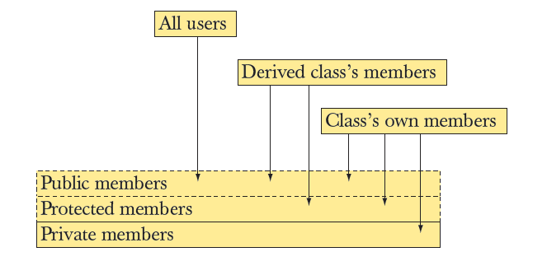
Access Model
A member (data, function, or type member) of a base can be
  Private, protected, or public

Slide 31
Public Inheritance
Public inheritance
class B : public A
Base class
Derived class
private
protected protected
public public
private
protected
public

Slide 32
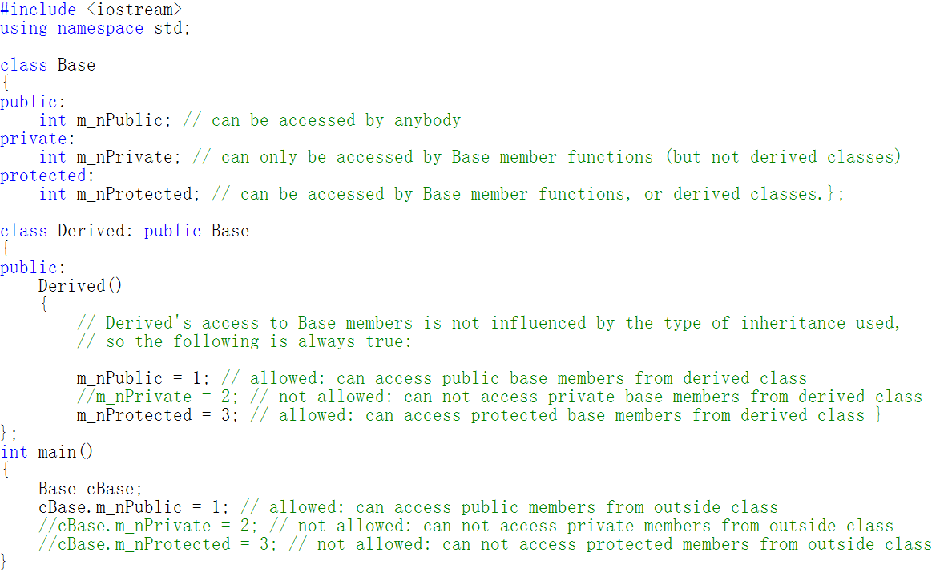

Slide 33
Public Inheritance
class A
{ public :
void get_XY( ) ;
void put_XY( ) ;
protected:
int x, y ;
};
void A::get_XY( )
{ cout << "Enter two numbers of x, y : " ;
cin >> x >> y ; }
void A:: put_XY( )
{ cout << "x = "<< x << ", y = " << y << '\n' ; }
class A
class B : public A
class C : public B

Slide 34
Public Inheritance
class B : public A
{ public :
int get_S() { return s ; };
void make_S() { s = x * y ; }; // use the base class member x，y
protected:
int s;
};
class C : public B
{ public :
void get_H() { cout << "Enter h : " ; cin >> h ; }
int get_V() { return v ; }
void make_V()
{ make_S( ); v = get_S() * h ; } // use base class function
protected:
int h, v;
};

Slide 35
Public Inheritance
void main()
{ A objA ;
B objB ;
C objC ;
cout << "It is object_A :\n" ;
objA.get_XY() ;
objA.put_XY() ;
cout << "It is object_B :\n" ;
objB.get_XY() ;
objB.make_S() ;
cout << "S = " << objB.get_S() << endl ;
cout << "It is object_C :\n" ;
objC.get_XY() ;
objC.get_H();
objC.make_V() ;
cout << "V = " << objC.get_V() << endl ;
}
x y
objA
objA.x
objA.y
s
objB
objB.x
objB.y
objB.s
h v
objC
objC.x
objC.y
objC.s
objC.h
objC.v

Slide 36
Public Inheritance
void main()
{ A objA ;
B objB ;
C objC ;
cout << "It is object_A :\n" ;
objA.get_XY() ;
objA.put_XY() ;
cout << "It is object_B :\n" ;
objB.get_XY() ;
objB.make_S() ;
cout << "S = " << objB.get_S() << endl ;
cout << "It is object_C :\n" ;
objC.get_XY() ;
objC.get_H();
objC.make_V() ;
cout << "V = " << objC.get_V() << endl ;
}
x y
objA
objA.x
objA.y
s
objB
objB.x
objB.y
objB.s
h v
objC
objC.x
objC.y
objC.s
objC.h
objC.v
Operate the data members of objA
Call the function of base class A to operate the data members of objB
Call the function of base class A to operate the data members of objC

Slide 37
Public Inheritance
x y
void main()
{ A objA ;
B objB ;
C objC ;
cout << "It is object_A :\n" ;
objA.get_XY() ;
objA.put_XY() ;
cout << "It is object_B :\n" ;
objB.get_XY() ;
objB.make_S() ;
cout << "S = " << objB.get_S() << endl ;
cout << "It is object_C :\n" ;
objC.get_XY() ;
objC.get_H();
objC.make_V() ;
cout << "V = " << objC.get_V() << endl ;
}
objA
objA.x
objA.y
s
objB
objB.x
objB.y
objB.s
h v
objC
objC.x
objC.y
objC.s
objC.h
objC.v
Call the function of derived class B to operate the data members of objB
Call the function of derived class C to operate the data members of objC

Slide 38
Private Inheritance
class B : Private A
Private inheritance
Base class
Derived class
private
protected
private
public
private
private
protected
public

Slide 39
Private Inheritance
class Student {
public: void input_data( );
……
};
class CollegeStudent : private Student{ // Private inheritance
……
};
int main(){
CollegeStudent cs;
cs.input_data(); // error
cs.input_major();
cs.print();
return 0; }

Slide 40
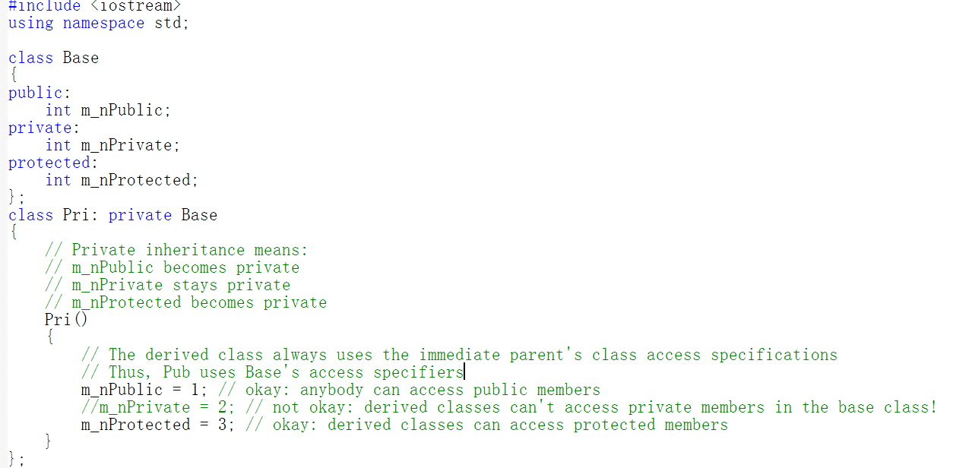

Slide 41
Protected Inheritance
class B : Protected A
Protected inheritance
Base class
Derived class
private
protected
protected
public
protected
private
protected
public

Slide 42
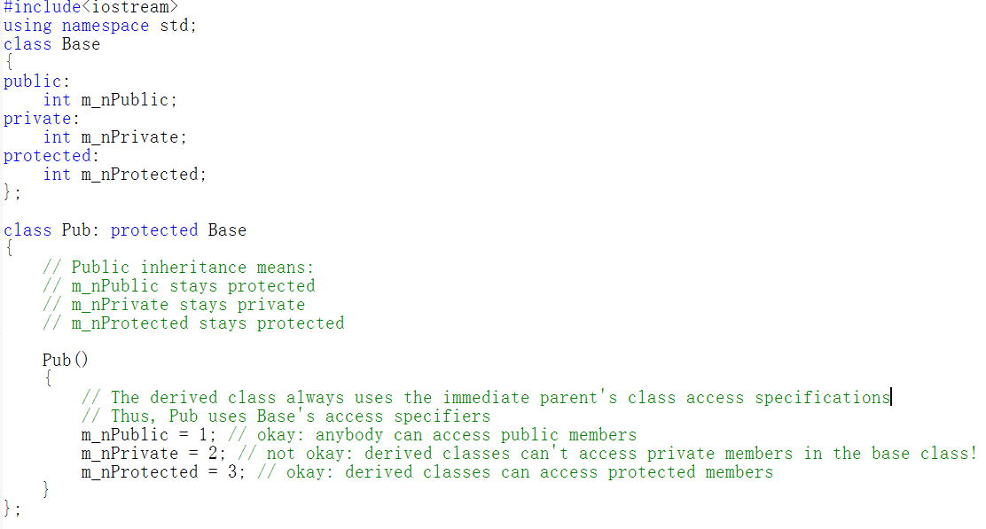

Slide 43
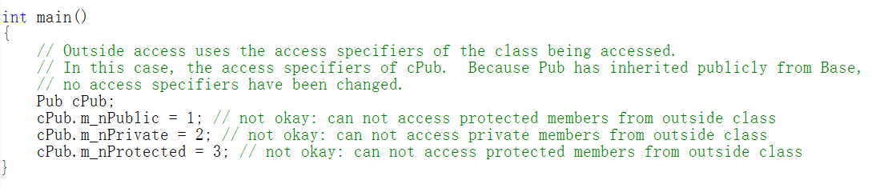
Example

Slide 44
Inheritance
class A
private
class B:public A
class C:private A
protected
private
public
private
Not allowed
protected
protected
A ObjA
public
public
B ObjB
C ObjC

Slide 45
Class Hierarchy
Members of a university
community
With multiple inheritance, a derived class inherits from multiple base classes.

Slide 46
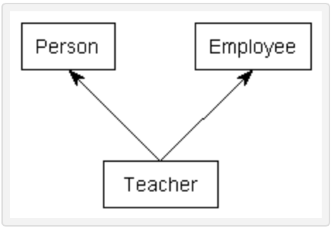
Multiple Inheritance（optional）
Multiple inheritance enables a derived class to inherit members from more than one base class.
To use multiple inheritance, simply specify each base class (just like in single inheritance), separated by a comma.

Slide 47
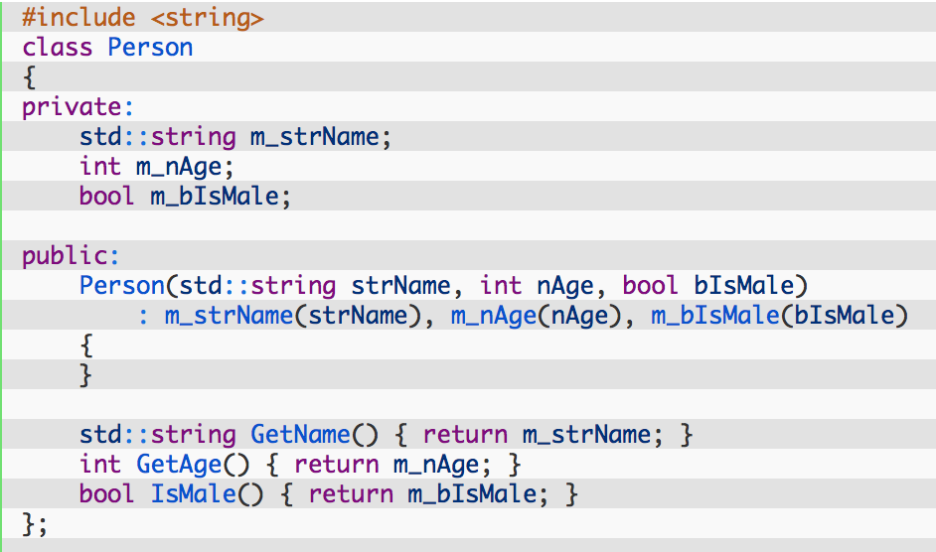
Example

Slide 48
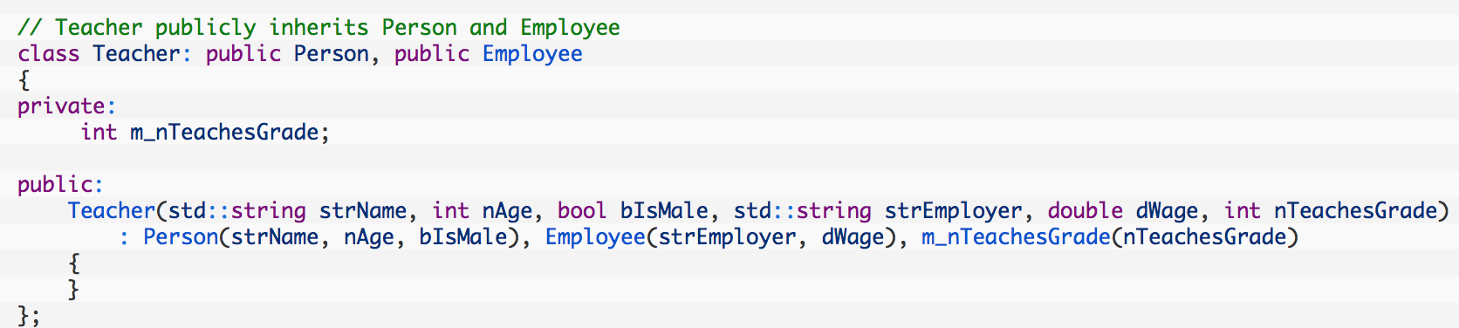
Example (con’t)

Slide 49
Problems with multiple inheritance
While multiple inheritance seems like a simple extension of single inheritance, multiple inheritance introduces a lot of issues that can markedly increase the complexity of programs and make them a maintenance nightmare
First, ambiguity can result when multiple base classes contain a function with the same name.
Second, and more serious is the diamond problem, which is call the “diamond of doom”. This occurs when a class multiply inherits from two classes which each inherit from a single base class. This leads to a diamond shaped inheritance pattern.

Slide 50
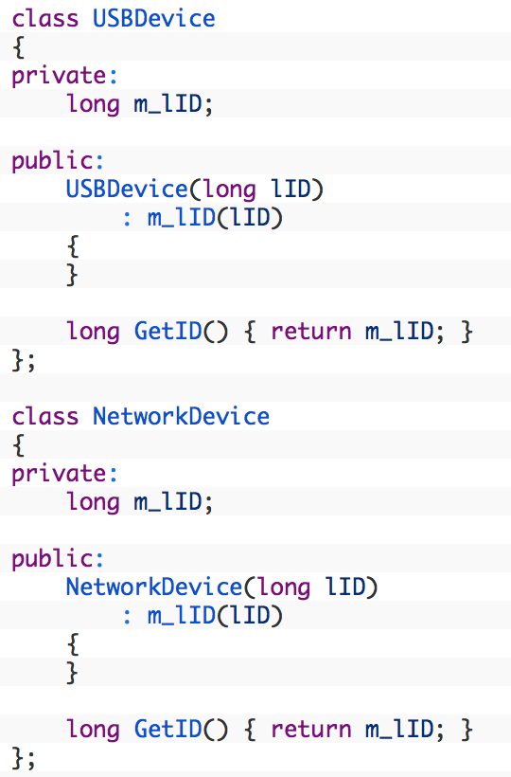
First example

Slide 51
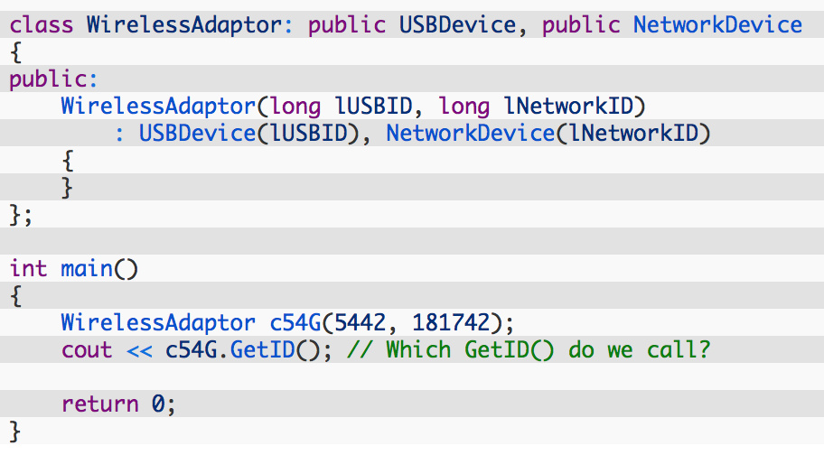
First example
this function call is ambiguous

Slide 52
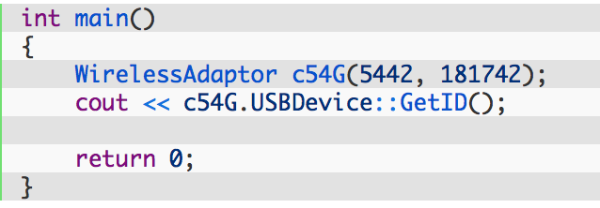
Solution

Slide 53
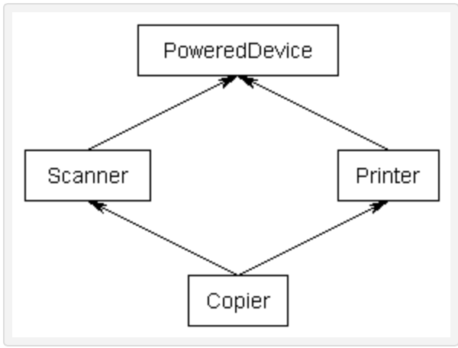
Second: Diamond of doom
In object-oriented programming, Deadly Diamond of Doom is a condition of ambiguity which arises due to multiple inheritance.
The phrase comes from the shape of the class diagram of the scenario showing the inheritance relations.

Slide 54
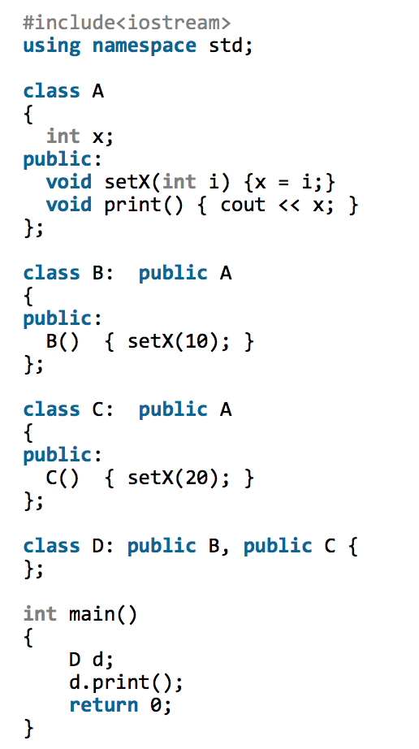

Slide 55
Virtual Base Classes
Used to prevent multiple copies of the base class from being present in an object derived from those objects by declaring the base class as virtual when it is inherited.
Syntax:
class derived : virtual public base
{ . . . };

Slide 56
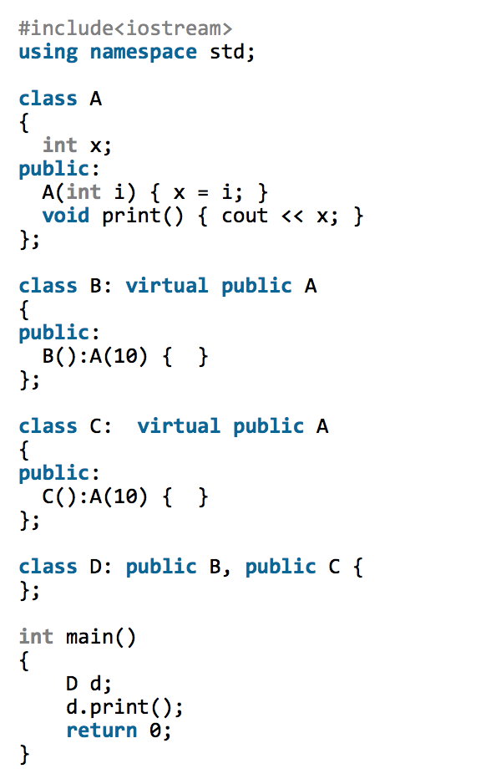

Slide 57
Is multiple inheritance more trouble than it’s worth?
Many authors and experienced programmers believe multiple inheritance in C++ should be avoided at all costs due to the many potential problems it brings.
Some do not agree with this approach, because there are times and situations when multiple inheritance is the best way to proceed. However, multiple inheritance should be used extremely judiciously.
As an interesting aside, you have already been using classes written using multiple inherited without knowing it: the iostream library objects cin and cout are both implemented using multiple inheritance.
Avoid multiple inheritance unless you know exactly what you’re doing!

Slide 58
Virtual Functions(*)
A virtual function is expected to be redefined in derived classes
Dynamic dispatch: selecting correct function at runtime
Once virtual, always virtual
class Cshape {
public:
void SetColor(int color) { m_nColor=color;}
virtual void Display( void) { cout<<"Cshape"<<endl; }
private:
int m_nColor;
};
class Crectangle: public Cshape {
public:
virtual void Display( void) { cout<<"Crectangle"<<endl; }
};
class Ctriangle: public Cshape {
virtual void Display( void) { cout<<"Ctriangle"<<endl; }
};
class Cellipse :public Cshape {
public:
virtual void Display(void) { cout<<"Cellipse"<<endl;}
};
Notes:
Once a method is declared virtual in some class C, it is virtual in every derived class of C, even if not explicitly declared as such. However, it is a good idea to declare it as virtual in the derived classes anyway for clarity.

Slide 59
Virtual Functions
void main()
{
  Cshape obShape;
  Cellipse obEllipse;
  Ctriangle obTriangle;
  Crectangle obRectangle;
  Cshape * pShape[4]= { &obShape,&obEllipse, &obTriangle,& obRectangle };
  for( int I= 0; I< 4; I++)
  pShape[I]->Display( );
}
#include<iostream>
using namespace std;
class Cshape {
public:
void SetColor(int color) { m_nColor=color;}
virtual void Display( void) { cout<<"Cshape"<<endl; }
private:
int m_nColor;
};
class Crectangle: public Cshape {
public:
virtual void Display( void) { cout<<"Crectangle"<<endl; }
};
class Ctriangle: public Cshape {
virtual void Display( void) { cout<<"Ctriangle"<<endl; }
};
class Cellipse :public Cshape {
public:
virtual void Display(void) { cout<<"Cellipse"<<endl;}
};
Cshape
Cellipse
Ctriangle
Crectangle
Remove the virtual?
Cshape
Cshape
Cshape
Cshape

Slide 60
Pure Virtual Functions
Often, a function in an interface can not be implemented
  E.g. the data needed is “hidden” in the derived class
  We must ensure that a derived class implements that function
  Make it a “pure virtual function” (=0)
This is how we define truly abstract interfaces (“pure interfaces”)
  struct Engine { // interface to electric motors
  // no data
  // (usually) no constructor
  virtual double increase(int i) =0; // must be defined in a derived class
  // …
  virtual ~Engine(); // (usually) a virtual destructor
  };
  Engine eee; // error: Collection is an abstract class

Slide 61
Pure Virtual Functions
A pure interface can then be used as a base class
  Constructors and destructors are described in detail in chapters 17-19
  Class M123 : public Engine { // engine model M123
  // representation
  public:
  M123(); // construtor: initialization, acquire resources
  double increase(int i) { /* … */ } // overrides Engine ::increase
  // …
  ~M123(); // destructor: cleanup, release resources
  };
  M123 window3_control; // OK

Slide 62
Technicality: Overriding
To override a virtual function, you need
  A virtual function
  Exactly the same name
  Exactly the same type
  struct B {
  void f1(); // not virtual
  void f2(char);
  void f3(char) const;
  virtual void f4(int);
  };
  struct D : B {
  void f1(); // doesn’t override
  void f2(int); // doesn’t override
  void f3(char); // doesn’t override
  void f4(int); // overrides
  };
Notes:
多态是面向对象中的一个重要的概念，virtual是为多态而生的。

Slide 63
Overriding vs Overloading
When overriding, you change the method behavior for a derived class.
Overloading simply involves having a method with the same name within the class.
Both of them belong to polymorphism!
overload(重载)，override (覆盖), hide (隐藏)

Slide 64
Inheritance?
  The same names of data members in base class and derived class?

Slide 65
Inheritance: The Same Name
class Person{ // base class
protected:
char name[10]; // name
char sex; // gender
int id; // identity ID
};
class Student : public Person{ // derived class
private: int id; // student Id
char school[10]; // school
public: void test(){ //test number
id=123;
}
};
//Which one？

Slide 66
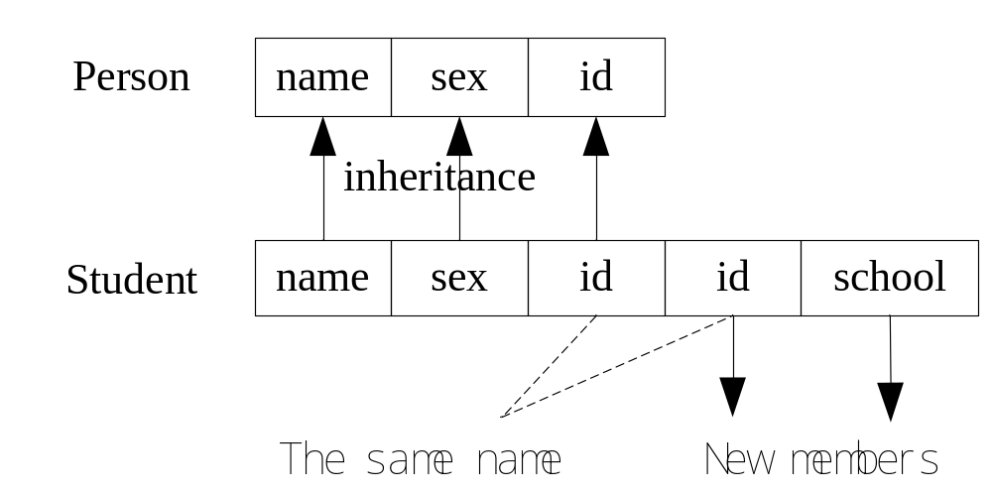
Inheritance: The Same Name

Slide 67
Inheritance: The Same Name
The way to solve this issue, using ”::”, such as
class: :member
class Student : public Person{ // derived class
private: int id; // student ID
……
public: void test(){
id=123; // call derived class member
Person::id =456; // call base class member
}
};

Slide 68
Language Mechanisms
Most popular definition of object-oriented programming:
  OOP == inheritance + polymorphism + encapsulation
Base and derived classes // inheritance
      struct Circle : Shape { … };
      Also called “inheritance”
Virtual functions // polymorphism
      virtual void draw_lines() const;
      Also called “run-time polymorphism” or “dynamic dispatch”
Private and protected // encapsulation
      protected: Shape();
      private: vector<Point> points;

